Slide 1

GROUP TWENTY-ONE(21)
GUIDING THE FUTURE OF ENERGY

Slide 2

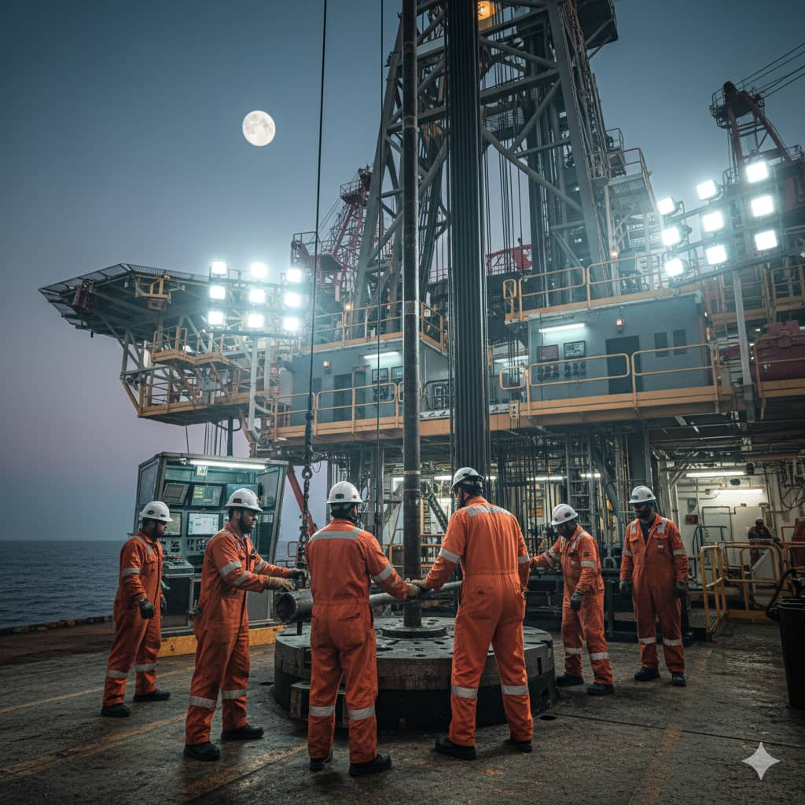
INTRODUCTION
Welcome to the forefront of energy innovation. At NextGen Petro-Tech, we specialize in bridging the gap between traditional oil and gas operations and the high-tech future of energy. Whether it’s enhancing recovery from mature fields or streamlining drilling efficiencies, we provide the technical precision required to power the world more intelligently.

Slide 3
COMPANY PROFILE
Our mission is to solve the most complex petroleum engineering challenges through a blend of advanced data analytics, optimized reservoir management, and sustainable extraction techniques.
The company combines education, safety, problem-solving, and career opportunities into one platform.

Slide 4
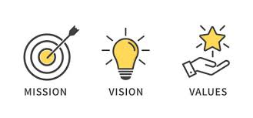
MISSION
VISION
CORE VALUES
Develop digital solutions that improve petroleum education, safety, and environmental responsibility
Empowering petroleum professionals and students through innovative and sustainable technology.
Innovation
Sustainability
Safety
Education
Excellence

Slide 5
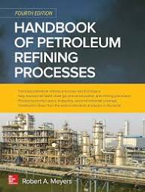
PROBLEM STATEMENT
Petroleum industry still relies on manual processes and delayed support which leads to inefficiency, safety risks, and environmental incidents.
Lack of centralized tools makes training and operations harder and there’s critical need for real-time guidance and digital solutions.

Slide 6


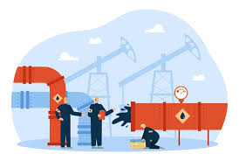


AIMS AND OBJECTIVES
Deliver interactive learning modules on petroleum engineering concepts.
Promotes safer and more sustainable petroleum operations by Providing real time hazard report
Connect users with internships and career opportunities in the petroleum industry
Offer an AI assistant for instant technical guidance

Slide 7
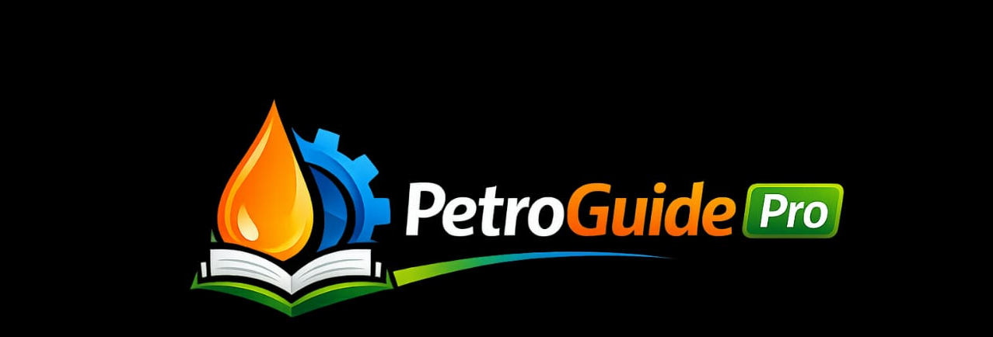
PetroGuide Pro was designed as the direct answer to our problems and to fulfill the aims of our company.
It is a digital platform that provides real-time guidelines and data-driven solutions that engineers need.
APP
DESCRIPTION

Slide 8
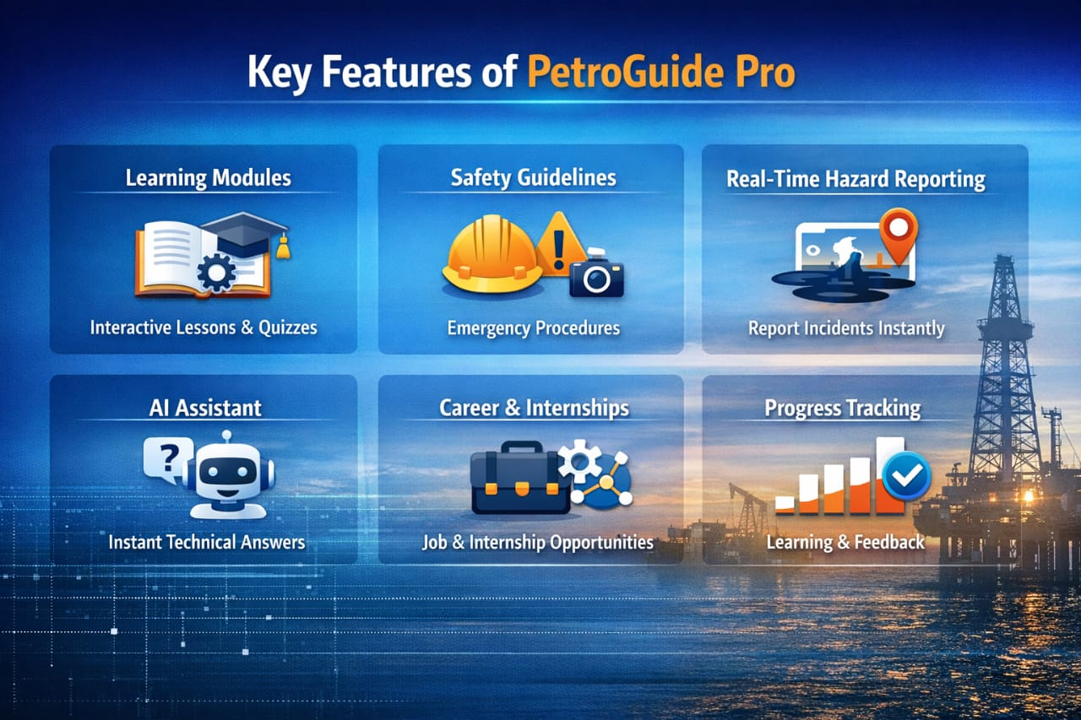
FEATURES OF THE APP

Slide 9
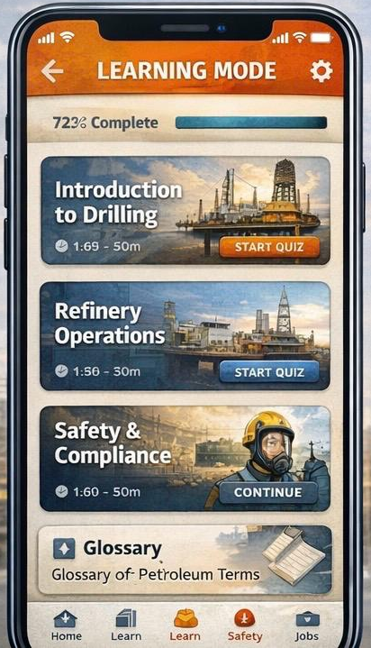
HOW THE APP WORKS

Slide 10
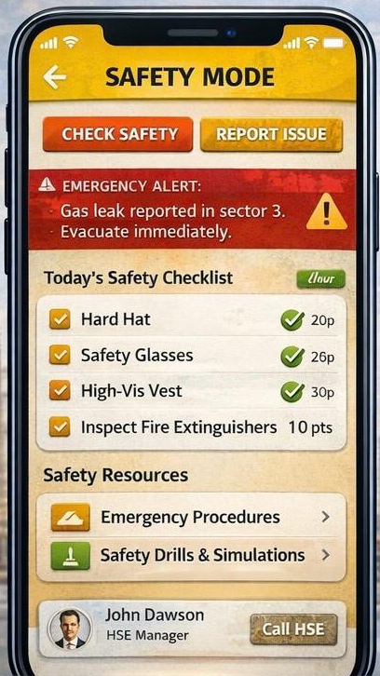
HOW THE APP WORKS

Slide 11
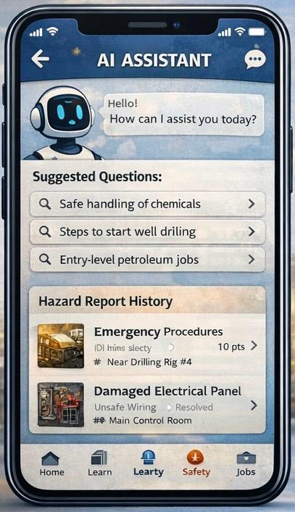
HOW THE APP WORKS

Slide 12
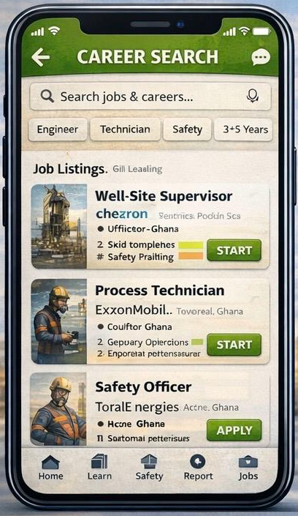
HOW THE APP WORKS

Slide 13




SDG’S ALLIGNMENT
REDUCING WASTE AND EMISSIONS TO SUPPORT CLIMATE ACTION(SDG 13)
IMPROVING ENERGY EFFICIENCY(SDG 7)
EMPOWERING WORKERS WITH SMART TOOLS TO SUPPORT ECONOMIC GROWTH(SDG 8)
DRIVING DIGITAL TRANSFORMATION WITHIN IDUSTRY INFRASTRUCTURE(SDG 9)

Slide 14
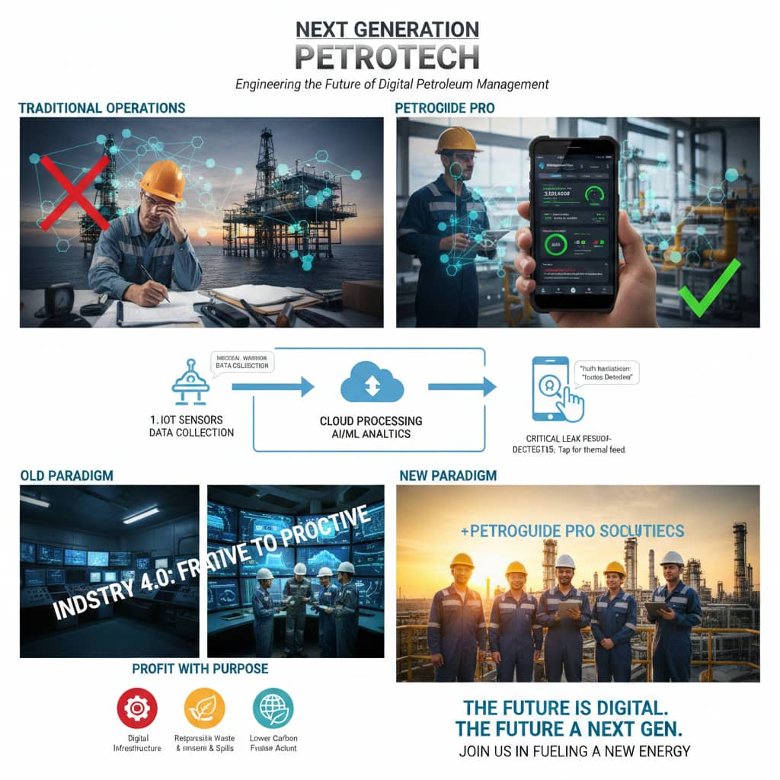
CONCLUSION
PetroGuide Pro is a smart platform that improves petroleum learning, safety, and operational efficiency. It empowers students and professionals with the tools they need to work safely and effectively while supporting innovation and sustainability in line with Agenda 2030.

Slide 15
NAME | INDEX NUMBER
NUKAMEWOR SARAPHINA | UEB0510425
OBUOBISAH ELIEZER NIINEY | UEB0501925
NTORI LILY TWENEBOAH | UEB0508625
BAIDOO VICTORY ALEX | UEB0518625
OFORI ALEXANDER | UEB0511625
HAMIDU ADNAN | UEB0514925
DAVID JESSE | UEB0514725
OFORI ANDY ASIRIFI | UEB0512425
ABDUL-AZIZ SALIFU SAKANDEH | UEB0522825
GYAN NATHANIEL | UEB0516225
ALAHASSAN FARHAN KANKO | UEB0517425
THANK
YOU

